Slide 1
DisordErs of haemostasis
© Oliver Rácz, 2021
In cooperation with
M. Macichova & B. Benova
SAFARIK UNIVERSITY
MEDICAL SCHOOL
DEPT. PATHOLOGICAL PHYSIOLOGY
KOSICE, SLOVAKIA
olliracz@gmail.com

Slide 2
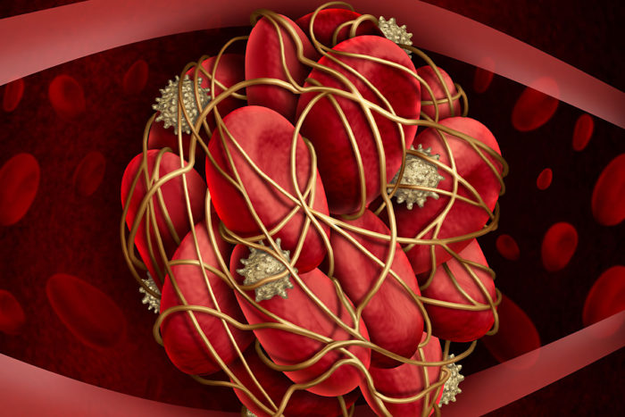
Syllabus
REPETITION OF PHYSIOLOGY
Basic description of haemostasis
II. REPETITION OF PHYSIOLOGY
Anticoagulants, fibrinolysis
III. METHODS OF INESTIGATION
IV. COAGULATION DISORDERS
V. THROMBOCYTE AND VASCULAR DISORDERS
VI. DISSEMINATED INTRAVASCULAR COAGULATION
VII. THROMBOPHILIA

Slide 3
Disorders of haemostasis, general overview
HAEMORRHAGIC DIATHESIS (BLEEDING)
(inherited and acquired)
Coagulation disorders (haemophilia, von Willebrand disease and others
Platelet disorders (thrombocytopenia, thrombocytopathies)
Disorders of the vessel wall (vascular purpuras)
DISSEMINATED INTRAVASCULAR COAGULATION
THROMBOSIS, EMBOLISM
Factor V Leiden and other hereditary forms of thrombophilia
Venous thromboembolism
Other forms of thrombosis, embolism

Slide 4
Disorders of haemostasis I repetition of physiology clot formation

Slide 5
The system of haemostasis
Maintains blood fluidity
Local clot formation after vessel injury
Maintains vessel wall integrity
Cooperation of vessel wall cells, thrombocytes, other blood cells, coagulation/anticoagulation factors & the fibrinolytic system
Nonhaemostatic functions of the system
Inflammation, immunity, glucose and lipid metabolism, angiogenesis, etc

Slide 6
History
Bleeding after circumcision – Talmud
Schmidt 1861 - Morawetz 1905
Thromboplastin
Thrombin
Fibrinogen
Calcium
1937 Quick, laboratory methods
1950 – 1959 DIC, Hardaway, McKay
1964 MacFarlane, Davie, Ratnoff - classic coagulation cascade
1974 The role of vitamin K
XXI. century – new conception, molecular basis of diseases

Slide 7
DISTURBED
INTEGRITY OF VESSEL WALL
VASOCONSTRICTION
seconds
PRIMARY
HAEMOSTASIS
3 – 7 min.
COAGULATION
5 – 10 min.
FIBRINOLYSIS
2 – 3 days
RESTORED
INTEGRITY OF VESSEL WALL

Slide 8
I Fibrinogen ⇒ fibrin
II Prothrombin ⇒ thrombin vit K, enzyme
III Tissue factor (thromboplastin) transmembrane protein
IV Ca²⁺
V Proaccelerin ⇒ accelerin
VII Proconvertin ⇒ convertin vit K, enzyme
VIII Antihaemophilic globulin not enzyme
IX Christmas factor vit K, enzyme
X Stuart factor vit K, enzyme
XI Plasma thromboplastin antecedent (PTA)
XII Hageman factor (???)
XIII Fibrin stabilising factor (FSF)
Prekallikrein ⇒ kallikrein
von Willebrand factor
High/low molecular weight kininogen (HMK, LMK)

Slide 9
Basic principle - proteolytic cascade
Some factors belong to group of serine proteases (inactive zymogens)
Activation cascade – amplification and possibility of regulation
Example: transformation of prothrombin to thrombin by activated factor X
S S

Slide 10
Basic principle – proteolytic cascade
Example: transformation of prothrombin to thrombin by activated factor X
Xa
S S

Slide 11
Basic principle - proteolytic cascade
Example: transformation of prothrombin to thrombin by activated factor X
Xa
S S

Slide 12
The role of vitamin K
Experiment: Rats with vitamin K deficiency
PIVKA = protein induced in vitamin K absence
Similar to prothrombin – not active
Vitamin K is the coenzyme of glutamate carboxylase, which converts
glutamic acid ⇒ γ-carboxyglutamic acid
Two COO⁻ s bind Ca²⁺
In prothrobin there are 10 such places

Slide 13
The role of vitamin K
O
-NH-CH-C-
CH₂
CH₂
COO⁻
O
-NH-CH-C-
CH₂
CH- COO⁻
COO⁻

Slide 14
The role of vitamin K (a coenzyme) Postsynthetic modification of certain coagulation (and also anticoagulant) factors
Glutamic acids
PIVKA
S-S
Enzyme with vit K
S-S
g-carboxyglutamic acids

Slide 15
New conception of coagulation
Initiation – minimal transformation of prothrombin to thrombin (no clot)
Amplification – clot formation
Termination – bleeding stopped
Also described as primary and secondary stage of haemostasis
Doubts about the in vivo role of „contact“ system (XII)

Slide 16
Initiation of coagulation
X
II
VII
TF
Monocyte
TF = FIII, (thromboplastin) CD142
A TRANSMEMBRANE RECPTOR

Slide 17
Tissue factor
TF = III, thromboplastin, CD142.
47 kD transmembrane protein, a cytokine receptor family member
Exprimed mainly on monocytes, smooth muscle cells, fibroblasts and in the subendothelial tissue
To a lesser extent in the brain (astrocytes), lungs, adipocytes, placenta
Broad range of expression activators and inhibitors

Slide 18
Amplification of coagulation I Activation of thrombocytes
vWf
II
VIII
X
V
thrombocyte
XI
IX
flip-flop of
phospholipids

Slide 19
Amplification of coagulation II Internal amplification loop
vWf
II
VIII
X
V
XI
IX

Slide 20
Amplification of coagulation III Activation of IX/VIII, formation of „tenase“
vWf
II
X
V
XI
IX/VIII

Slide 21
Amplification of coagulation IV formation of prothrombinase
vWf
II
XI
IX/VIII
X/V

Slide 22
Amplification & termination
Activation of thrombocytes, flip-flop of phospholipids
Activation of XI – amplification loop
Activation of IX and VIII → TENASE
Tenase activates X and V – PROTHOROMBINASE
Production of huge amounts of thrombin
Transformation of fibrinogen to fibrin → CLOT
Formation of crosslinks in fibrin network (XIII) → STABLE CLOT

Slide 23
Amplification & termination
Activation of thrombocytes, flip-flop of phospholipids
Activation of XI – amplification loop
Activation of IX and VIII → TENASE
Tenase activates X and V – PROTHOROMBINASE
Production of huge amounts of thrombin
Transformation of fibrinogen to fibrin → CLOT
Formation of crosslinks in fibrin network (XIII) → STABLE CLOT
This is a very complicated
nonlinear system

Slide 24
Revision of „contact“ system
John Hageman (deficiency of XII) died in 1968 on thrombembolic disease after a trauma
He probably did not read the textbooks of physiology!
According to current opinion the system has rather nonhaemostatic functions

Slide 25
Structure of fibrinogen
6 chains, 2* α, β, γ
Proteolytic removal of peptides A,B
Polymerisation

Slide 26
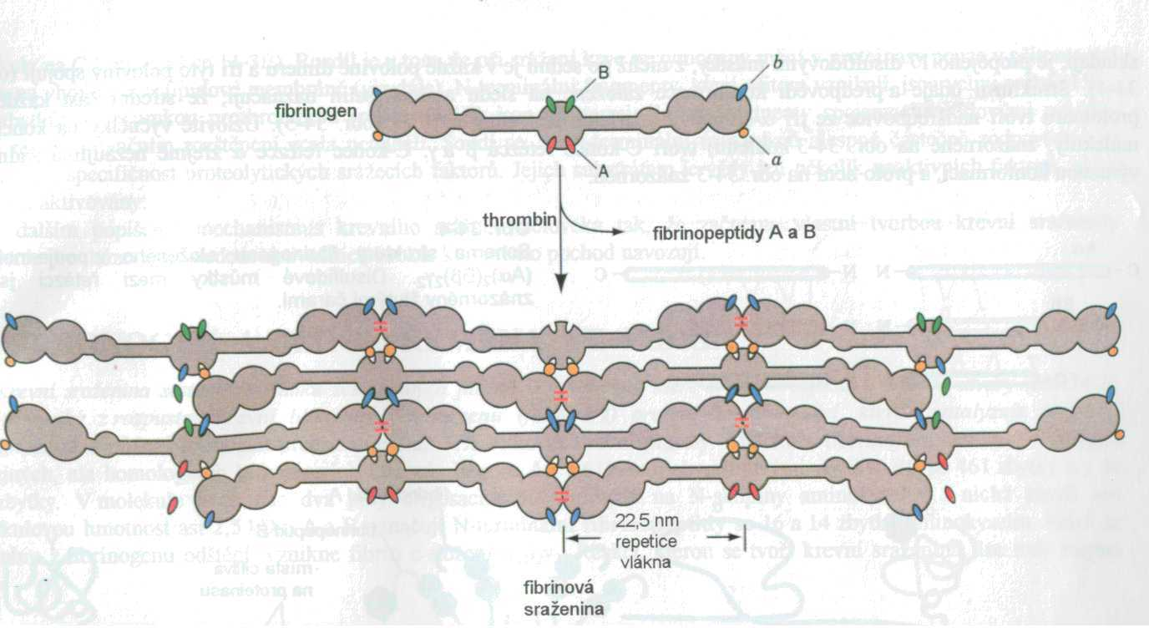
Polymerisation of fibrinogen
“holes” in the middle
+
“pegs” at the ends
of adjacent molecules
Polymer network
In reality electrostatic
interactions

Slide 27
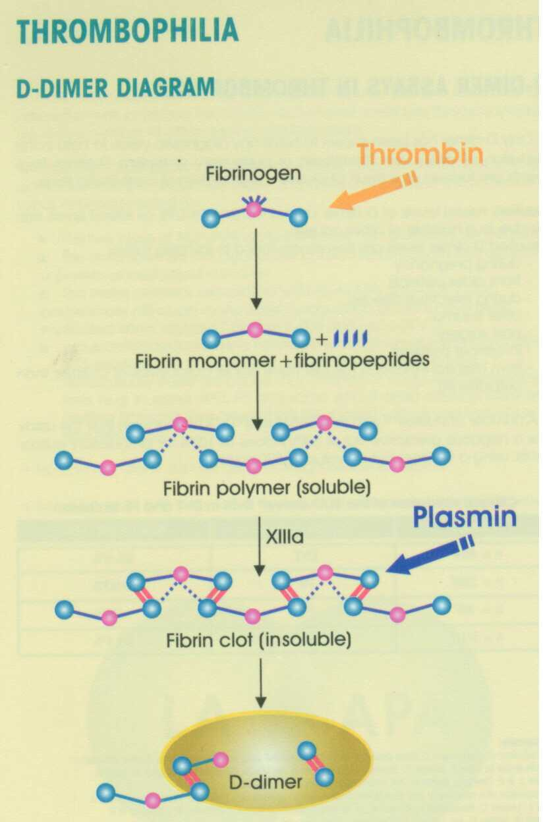
Stabilisation of fibrin and fibrinolysis
Factor XIII makes very strong covalent bonds between “D” parts of fibrin
These are not dissolved by plasmin,
The D-DIMERS
are important markers of fibrinolysis

Slide 28
Disorders of haemostasis II repetition of physiology the anticoagulant and fibrinolytic system

Slide 29
Anticoagulant system
THREE POSSIBILITIES OF NEGATIVE REGULATION
IN PHYSIOLOGICAL CONDITIONS EQUILIBRIUM “PRO” AND “ANTI”
I. Serpins – inhibitors of proteases
Inhibitor of initiation - TFPI
Antithrombin (III)
II. Protein C together with S are the most important inhibitors of amplification – proteolytic degradation of V and VIII
III. Blockade of phospholipids on platelet membrane – anexin V

Slide 30
The fibrinolytic – plasminogen system
PLASMINOGEN – 92 kDa glycoprotein
Two step activation to active form, PLASMIN by tissue PLASMINOGEN ACTIVATOR – tPA
Plasmin degrades fibrin clot (and has a lot of nonhaemostatic functions)
The process is inhibited by PAI – 1, an antagonist of tPA
Important – the activities of tPA and PAI are oscillating in a broad range – effects of stress, adrenaline, antidiuretic hormone, obesity (!) and gene polymorphism
Another delicate and dynamic equilibrium

Slide 31
FIBRIN CLOT
FDP
D-DIMERS
PLASMIN
PAI-1
-
+
tPA
PLASMINOGEN

Slide 32
Disorders of haemostasis IiI methods of investigation

Slide 33
Diagnostics I
PAST
Rumpel-Leede, test of capillary fragility
Bleeding time (standardized methods!)
normal: 4 - 6 min.; pathological: > 10 min.
Whole blood coagulation time (Lee-White)
normal: 4 - 8 min.
Platelet count (automatic analyzers)
norm: 140 – 440*10⁹ L⁻¹
100*10⁹/ L⁻¹ thrombocytopenia
50*10⁹/ L⁻¹ risk of longer bleeding after an injury
or surgery
40*10⁹/ L⁻¹ spontaneous bleeding (or not)
10*10⁹/l L⁻¹ danger of fatal bleeding (GIT, NS)
PLATELETS
Broad range of normal
Values
In case of decrease
nothing for a long time
After a critical point
suddenly serious problems
Follow the dynamics!

Slide 34
Diagnostics II principle of coagulation tests
Step 1: Anticoagulated blood (Ca²⁺ binding by citrate);
Step 2: Removal of RBC, LE, TH (careful centrifugation)
The supernatant plasma contains the coagulation factors
Step 3: Addition of surplus Ca²⁺ & activators to plasma
Step 4: Measurement of time until the first fibrin filaments are formed
Expression of results
A. In seconds (international standardized calibrators, QC)
B. In relative units compared to norm (time patient/control)
INR = International Normalized Ratio
High INR = slow coagulation, low INR = danger of thrombosis

Slide 35
Diagnostics III coagulation tests - examples
Prothrombin time - Quick
Oral anticoagulant therapy control (OAC)
Plasma + Ca²⁺+ tissue thromboplastin
Norm: 11 – 15 sec
Necessary factors: VII, X, V, II
APTT = activated partial thromboplastin time
Plasma + Ca²⁺ + caolin (negat. charge) + phospholipid
Norm: 35 – 45 sec.
Necessary factors: XII, XI, IX, and VII, X, V, II

Slide 36
Prothrombin and APTT assay
APTT
AN OVERALL
PICTURE OF
COAGULATION
NO INFORMATION
ABOUT THE CONCENTRATION OF FACTORS
Prothrombin (Quick)

Slide 37
Diagnostics IV - other assays
Fibrinogen concentration (2 – 4 g/l)
Fibrin & fibrinogen degradation products replaced today with D-dimer, important in the
diagnostics of DIC
exclusion of deep venous thrombosis and pulmonary embolism (limit 500 μg L^{-1 /})
Special assays – aggregometry, adhaesion of thrombocytes
Direct measurement of factors (very low concentrations)
Assays of polymorphisms, mutations

Slide 38
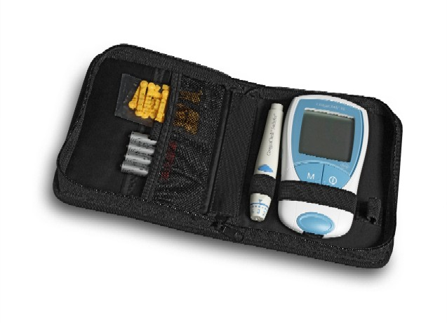
CoaguChek XS Home monitoring of PT

Slide 39
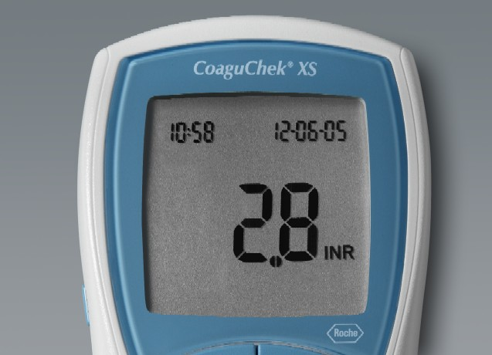
CONTROL OF ANTICOAGULANT THERAPY AFTER MYOCARDIAL INFARCTION

Slide 40
Disorders of haemostasis IV Haemorrhagic diatheses, coagulopathies

Slide 41
Hereditary disorders of coagulation*
Hemophilia A (factor VIII; 1/10 000 boys)
Unexpected fluctuation of clinical symptomatology
Long repeated bleedings
Internal bleedings
Intracranial bleeding (can be fatal)
Chronic anaemia, icterus
Severe damage of joints
Hemophilia B (IX factor – XR heredity) C (XI factor – AR heredity), less severe
*REPEAT GENETICS!

Slide 42
Factor VIII concentration and symptoms

Slide 43
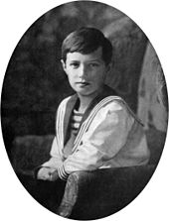
The Queen and epidemiology today
Queen Victoria 1819 – 1901, 9 children
First carrier?
Carriers Alice and Beatrice (2/5 daughters)
Affected Leopold, 1853 – 1884 (1/4 sons)
Edward VII, the next king, healthy
Alexandra, granddaughter of Alice carrier
Alexandra and Alexei (1904 – 1918, Russia)
4 daughters and one affected son
Charles, Wiliam, Harry, George (descendants of Edward VII, healthy)
They had haemophilia B and not A!
HEMOPHILIA (ALL)
172 000 worldwide
60% severe, classic mutation (f. VIII gene inversion)
15% moderate (1-5 % activity)
25% mild (6-30%)
Moderate and mild, more “B” and other

Slide 44
Treatment
1840 – First attempts with blood transfusion
1923 – Treatment with blood plasma
1960’s Insufficent control of blood donors ≈ 40 000 HIV INFECTIONS
1989 – Genetic engineereing, production of pure factors in yeast and bacteria
2014 – Factor VIII with prolonged effect
Perspective: gene therapy (gene transfer into thrombocytes). Our dogs are helping - they also have haemophilia
Better treatment of joint damage
A new problem: Antidrug autoimmunity (ADA), possibility to treat by nanotechnology (protein + inhibitor of immune response in nanoparticles)

Slide 45
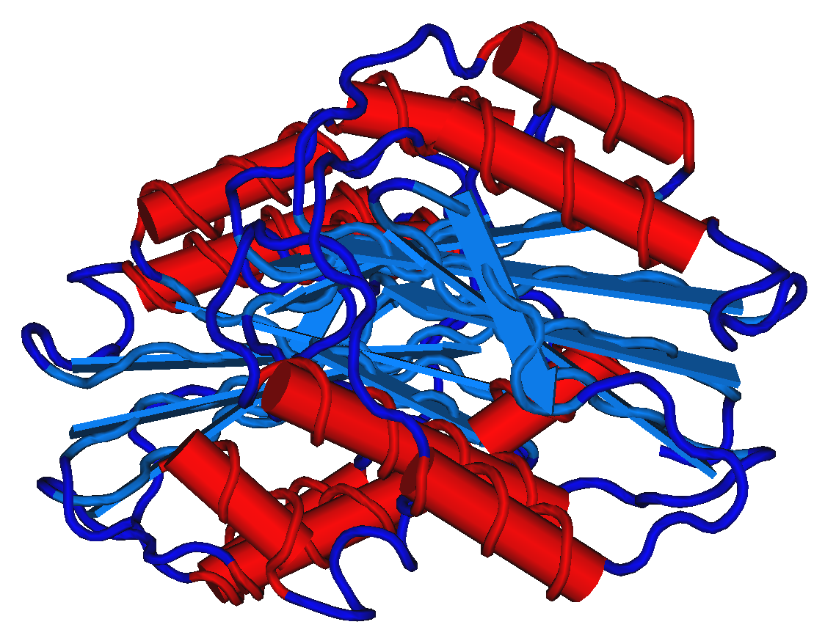
von Willebrand disease
In the past considered as a moderate form of hemophilia
Von Willebrand factor = big multimeric protein
Synthesised in endothel and megakaryocytes
Function – contact of damaged endothel and platelets, mutual interaction of thromobocytes
Stabilisation of factor VIII.
Concentration in people with blood group AB > 0

Slide 46
von Willebrand disease
Deficiency in 1 – 3 % (or less?) of population, mostly asymptomatic
Cumulation with other factors (acetylsalicylic acid and other) possibility of mucosal bleeding, long bleeding after dental surgery, metrorrhagia
More types I (common), IIa, IIb, III (rare)
Therapy with vasopressine analogues

Slide 47
Acquired coagulopathies
Vitamin K deficency
Newborns, malabsorption, obstructive icterus, etc.
Anticoagulant drugs
Dicumarol derivatives (antivitamin K);
Heparin (activator of antithrombin, inactivation of factors X,IX & XI)
Streptokinase
Liver failure. Common cause of decreased coagulation in everyday medicine!
Low level of fibrinogen amd other factors

Slide 48
Disorders of haemostasis v Haemorrhagic diatheses, thrombocyte & vessel wall disorders

Slide 49
Thrombocytopenia & thrombocytopathy
Different conditions (number and function) but often combined
The development of platelets from megakaryocytes is very complicated
Regulator: Thrombopetin. Megakaryocytes are polyploid!
From one megakaryocytes approximately 20 pro-platelets, after release into circulation pre-platelets and finally maturation. Thrombocytes live 8 – 10 days
Small fragments without nucleus but full of organelles, different granules, RNA, proteins and organic compounds (ADP, ATP, serotonine and others). Big number of membrane receptors. Prostaglandine synthesis
After activation change of shape, adhesion, secretion, aggregation
Role both in primary and secondary haemostasis
Nonhaematological functions (inflammation, immunity)

Slide 50
Thrombocytopenia – three processes
A. Insufficient production of megakaryocytes (often with anaemia)
Bone marrow damage: drugs, chemical compounds, radiation, infections, tumors, leukemia, fibrosis
Congenital – hereditary forms of bone marrow insufficiency
Deficiency of cobalamine and folic acid
B. Increased destruction of thrombocytes
Autoimmunity – Idiopatic thrombocytopenic purpura (ITP) – relatively common
Fetal/maternal blood group incompatibility
Disseminated intravascular coagulation
Arteficial heart valves in the past
C. Abnormal distribution of thrombocytes in circulation

Slide 51
Thrombocytopathies
Acquired
Long-term use of acetylsalicylic acid, phenylbutasone
Uremia
EBOLA and other viroses
COVID 19, with endothel damage
Congenital – rare (high number)
Bernard – Soulier syndrome, AR heredity, deficiency of the glycoprotein Ib-IX-V complex (GPIb-IX-V), the receptor for von Willebrand factor.
Congenital amegakaryocytic trombocytopenia
Thrombastenia – m. Glanzman, AR heredity, insufficient platelet aggregation

Slide 52
Vascular purpura
Relatively common conditions (in practical medicine not considered as haematological disease)
Skin eruption in infectious diseases in children
Senile purpura
Scorbut, scurvy – deficiency of vitamin C
Disorder of collagen synthesis (proline - hydroxyproline) and abnormal platelet function. Perifollicular skin, gingival, mucosa muscle, GIT bleeding, hematuria. Skin hyperkeratosis.
Endothelopathy in COVID-19

Slide 53
Hereditary disordes of vessel wall
Hereditary haemorrhagic teleangiectasy
(m. Osler-Weber-Rendu), AD,
Epistaxis, teleangiectasy
Anaemia, DIC, liver cirrhosis
Lack of elastic fibers in vessel wall
Other hereditary collagen diseases
Marfan – Lincoln, Ehlers-Danlos – Paganini

Slide 54
Disorders of haemostasis vi disseminated intravascular coagulation

Slide 55
Disseminated intravascular coagulation, DIC
Older name: Consumption coagulopathy
Life threating disorder (Death Is Coming !)
Generalised activation of haemostasis
Thrombosis and bleeding at the same time, tissue hypoxia

Slide 56
DIC - causes
Complications of gravidity. Amniotic fluid embolisation. Preeclampsia, eclampsia
Sepsis & septic shock G- infections (endotoxin), meningococci, pneumococci, plasmodium malariae
Syndrome Waterhouse-Friederichsen as a consequence of meningitis
Neoplastic disease: Lung, gastric, breast, prostata Ca, leukemia
Liver failure
Haemolysis (incompatible transfusion)
Trauma (haemorrhagic shock, burns)
Rejection of transplanted organs
Tropical snake toxins

Slide 57
Pathogenesis of DIC
Generalised activation of coagulation
Thrombosis
Microthrombi in circulation;
Deposits of microthrombi in tissues and their damage
Decreased haemostasis
Decrease of platelet number, factor concentration
Activation of fibrinolysis
Bleeding
Disorder of nonhaemostatic functions of the system
HIGH MORTALITY IN FULLY DEVELOPED CASES!

Slide 58
GENERALISED ACTIVATION OF COAGULATION
MICROTHROMBI
EMBOLISATION
DECREASE OF PLATELETS
& COAGULATION FACTORS
ACTIVATION OF FIBRINOLYSIS
BLEEDING

Slide 59
Symptoms and forms
Tissue ischaemia, gangrena of fingers
Bleeding (after injections);
Kidney failure, anuria;
Haemorrhagic necrosis of adrenal cortex - sy Waterhouse-Friderichsen (as a complication of meningitis;
haemolytic anaemia, haemoglobinuria);
Paralysis of nerves
Beginning acute or subacute
Stages: Compensated, decompensated and manifest

Slide 60
An older case study
Rapid fall of
thrombocytes!
FDP = fibrin degradation
products, today replaced
With D-dimers

Slide 61
Disorders of haemostasis viI thrombophilia

Slide 62
Incidence of venous thromboembolism (VTE)
CAUSES OF DEATH (EU one year)
53,599 traffic accidents
63,636 men, prostate cancer
86,831 women, breast cancer
543,454 VTE
SURGERY
General surgery, urology 15-40 %
Hip joint replacement 40-60 %
Big trauma 40-80 %
AGE DEPENDENT RISK
< 20 years 1/100 000
20 – 40 years 1/10 000
> 70 years 1/100 !!??
AND GENETIC BACKGROUND???
POSITIVE : 1/10 NEGATIVE: 1/100 000
!!!

Slide 63
Thrombosis, thrombembolia, thrombophilia
Factors
endothel (aterosclerosis, inflammatio)
thrombocytes
coagulation pro & contra, fibrinolysis (tPA/PAI!)
circulation (stasis)
Forms
venous thrombosis
arterial (MI)
intracardial (mitral stenosis)
diffuse (DIC)
Occlusive – nonocclusive clots
Embolia – lung, brain, paradox, microembolisation

Slide 64
Trombophilia, complex disease
Immobilisation
Stasis
Varices
Smoking
Gravidity,
hormonal anticonception
Trauma, burns
Malignant tumors
ATHEROSCLEROSIS
DEFICIENCY OF ANTICOAGULANT FACTORS
INCREASED ACTIVITY OF PROCOAGULANT FACTORS (VIII)
DECREASED FIBRINOLYSIS

Slide 65
Trombophilia, complex disease – prevalence of mutations and polymorphisms (heteroyzgotes)
Deficiency of antithrombin III (1965) 0,2
Deficiency of protein C (1980) 0,8
Deficiency of protein S (1984) 1,3
Faktor V Leiden (1994) 3 !!!
Prothrombin (G20210A) (2000) 2,3 !!!
Combinations are also possible

Slide 66
APC resistance (Activated Protein C)
Factor V Leiden
(R506Q), 2 – 10 % europoid population (SK 5 %)
4 – 7fold increase risk of thrombosis in heterozygotes,
In combination with other factors (smoking, anticonception) possible thrombosis
Geographic gradient form south to north
Other mutations (Factor V Cambridge, Hongkong) rare
Polymorphism of protein C gene and other genes of coagulation/fibrinolysis factors
Functional APC resistance
Increase of f VIII, decrease of protein S in gravidity, during hormonal anticonception, inflammation, obesity, malignant tumors

Slide 67
Factor V Leiden is working well but does not inactivate by APC
APC
X/V Leiden

Slide 68
Our case study
As an editor of a medical journal we visited our publisher, a cca 50 y old lady
Complaining about respiratory condition, therapy resistant
And also swelling of the legs
Nothing serious?
Immediately sent to hospital:
D-dimers extremely high
X-ray multiple small pulmonary embolization
Venous thrombembolism

Slide 69
Bleeding and thrombosis !
Hemophilia: 1/10 000 (Sk 400)
Other (low platelets, etc. ) are not very rare but some are nor clinically manifest (vWd)
Trombophilia and VTE 1/10 in older obese and otherwise ill people
EU: 540 000 deaths, late diagnosis, no diagnosis, bad diagnosis!!!

