Slide 1


PATHOLOGICAL PHYSIOLOGY OF CARDIOVASCULAR DISEASES
© Oliver Rácz, eva sedláková
EVA LOVÁSOVÁ, peter dombrovský
2024

Slide 2
PATHOLOGICAL PHYSIOLOGY OF CARDIOVASCULAR DISEASES part 1
heart and circulatory failure 3 – 25
Acquired valvular diseases 26 – 51
Congenital heart diseases 52 – 80

Slide 3

Lectures & seminars from pathological physiology
Chapter I
Heart and Circulatory Failure
Oliver rácz et al, 2024

Slide 4
Heart failure – basics
Clinical syndrome (not a disease)
Consequence of different diseases
Acquired/inherited abnormality of cardiac function/structure
Constellation of symptoms – dyspnea, fatigue, edema, rales…
Frequent hospitalization, poor quality of life, shortened life expectancy
Despite (or due to!) better treatments increasing prevalence
    Aging of the population, longer survival of cardiac patients

Slide 5
New concept
Old: Cardiac dropsy* due to decompensation of ventricular hypertrophy
Recent: Neuroendocrine, hormonal and inflammatory factors, molecular mechanism of adaptation and deadaptation – not only the contractile elements
Ventricular remodeling
Both systole and diastole impaired
For clinicians:
Earlier identification, intervention, better therapy
Dropsy = hydrops, stasis

Slide 6
Heart failure, forms and classifications
Forward and backward failure (in each case)
Blood is accumulating before the obstacle and behind it the perfusion is impaired
NYHA classification I – IV
According to symptoms
Forms
  Left ventricle, right ventricle, both
  Acute and chronic (myocardial infaction/hypertension)
  Systolic and diastolic dysfunction
  Decrease of cardiac output (CO) and/or ejection fraction (EF), sometimes no decrease

Slide 7
NYHA*, four stages
Patient with cardiac disease but without resulting limitation of physical activity. Ordinary physical activity does not cause fatigue, palpitations, dyspnea or anginal pain.
Patient with cardiac disease resulting in slight limitation of physical activity. Comfortable at rest. Ordinary physical activity results in fatigue, palpitations, dyspnea or anginal pain.
Patient with cardiac disease resulting in marked limitation of physical activity. Less than ordinary physical activity results in fatigue, palpitations, dyspnea or anginal pain
Patient with cardiac disease resulting in inability to carry on any physical activity without discomfort. Symptoms of heart failure or anginal syndrome may be present even at rest. If any physical activity is undertaken, discomfort is increased.
*New York Heart Association

Slide 8
according to ejection fraction (EF)
0,80 – 0,55 | Norm
0,55 – 0,44 | Mild systolic dysfunction
O,44 – 0,30 | Medium systolic dysfunction
< 0,30 | Severe systolic dysfunction
The normal volume of ventricles in adults is ≈ 100 ml
If EF = 0,70 the ejected volume is 70 ml
No information about diastolic dysfunction

Slide 9
Cardiac cycle in mild tachycardia in health and in heart disease
FREQUENCY AND CYCLE DURATION 116/min; 0,52 s | HEALTHY HEART | POŠKODENÉ SRDCE | DAMAGED HEART
PHASE | TIME: miliseconds
Isometric contraction | 0,055 | 0,105 ↑↑
Ejection | 0,155 | 0,165 ↑
SYSTOLE TOGETHER | 0,210 | 0,270 ↑↑
Isometric relaxation | 0,075 | 0,090 ↑
Rapid filling | 0,060 | 0,040 ↓↓
Diastase | 0,085 | Skoro 0 ↓↓↓
Atrial systole | 0,090 | 0,120 ↑↑
DIASTOLE TOGETHER | 0,310 | O,250 ↓↓
Weakness of heart muscle is manifesting with longer systole leaving less time for ventricle filling in diastole

Slide 10
Attempt for a Universal (exact) definition
Current situation: symptoms and signs which are not objective, not enough sensitive and specific Late diagnosis
  Dyspnoe, fatigue, rales, pulmonary crackles, oedema…)
An attempt to find a universal definition based on natriuretic peptide levels (Cleland et al, 2021)
  Early elevation
  Secreted from dilated left atrium
Counterpoint (Pfeffer, Teerlink, 2021)
  Not yet ready for general acceptation (NP measurements are routine, not for definition, but for assessment of HF)
  HF has many causes and forms (in contrast to CAD)
Bauersachs J; Cleland et al; Pferffer & Teerlink – European Heart J 2021, 42, 2331-2343

Slide 11
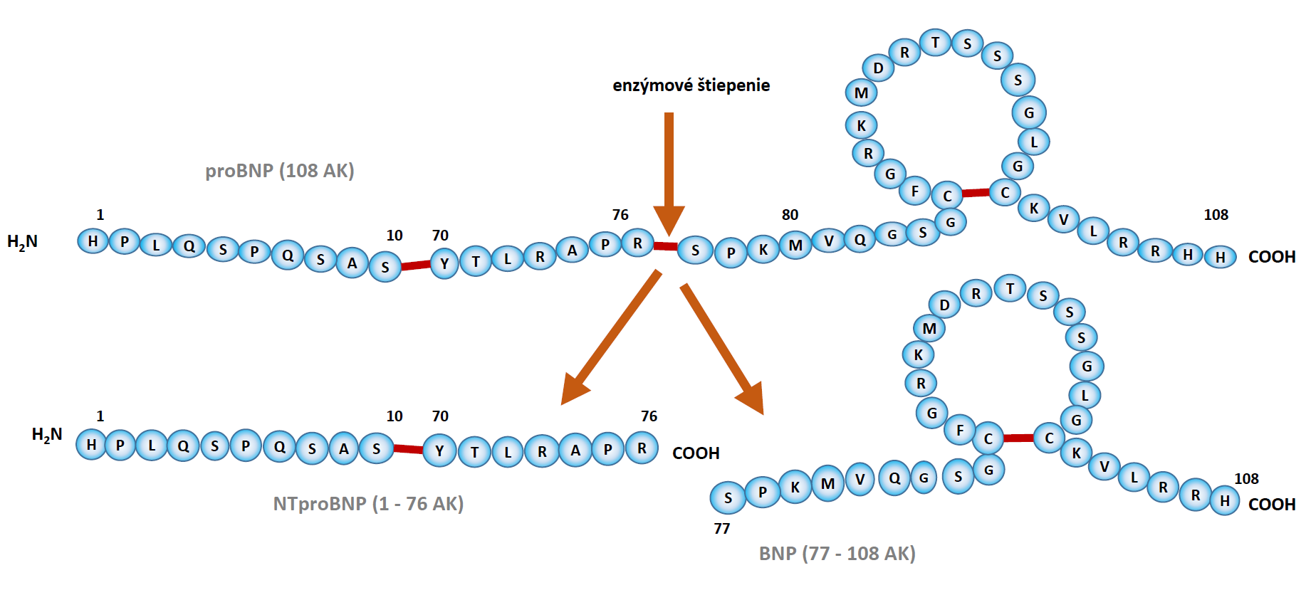
natriuretic peptide bnp, its precursor probnp
and its amino terminal peptide: NT- probnp
Enzyme
Comments:
In the body the circular part is responsible for the effect as natriuretic factor
In laboratory assay the inactive part (NT-proBNP) of the hormone is measured (stable)

Slide 12
The natriuretic peptides
1981 de Bold et al: Extracts from cardiac atria have natriuretic, diuretic and vasodilatatory effects
End of XXth Century: Isolation and identification of 3 oligopeptides – A (atrial), B (brain) & C natriuretic peptides,
ANP 28 aminoacids. (BNP 32, CNP 22) and some similar compounds discovered later
BNP is also synthetized in heart – mostly in cardiomyocytes of atria and ventricles
Structure and function – see biochemistry & clinical chemistry
Laboratory assay: The best marker of cardiac function is the NT-proBNP, which is the N-terminal part of the BNP prohormone (76 aminoacids). Is stable and a very good marker of cardiac dysfunction. Problem: Its normal reference range is age and sex dependent
Values in ng/L
The reference ranges,
thresholds are not
universally accepted
Lazúrová I: Hormóny kardiovaskulárneho systému 2002
Ďurovcová E et al: Klinická biochémia, 2020
AGE, years | MEN | WOMEN
< 60 | > 75 | > 125
60 – 69 | > 125 | > 175
70 – 80 | > 175 | > 225
> 80 | > 250 | > 250

Slide 13
Phases of congeStion
A. PHYSIOLOGY
  Plasma volume 3,0 L, Extracellular fluid (ECF) volume 11,0; left atrium normal
B. ISOLATED CONGESTION
Plasma volume 3,6 L, ECF 11,0 L; left atrium volume increased, wall stress
No clinical signs
C. SUBCLINICAL CONGESTION
Plasma volume 3,6 L, ECF 13,2 L; left atrium volume increased, wall stress;
Decreased exercise capacity (nonspecific),
Radiological and ultrasonographic signs present
D. CIRCULATORY AND TISSUE CONGESTION, SYMPTOMS ON EXERCISE (NYHA II – III)
Plasma volume 3,8 L, ECF 13,8 L; left atrium volume increased, wall stress;
E. CIRCULATORY AND TISSUE CONGESTION, SYMPTOMS AT REST (NYHA IV)
Plasma volume 4,0 L, ECF 18,0 L; left atrium volume increased, wall stress;

Slide 14
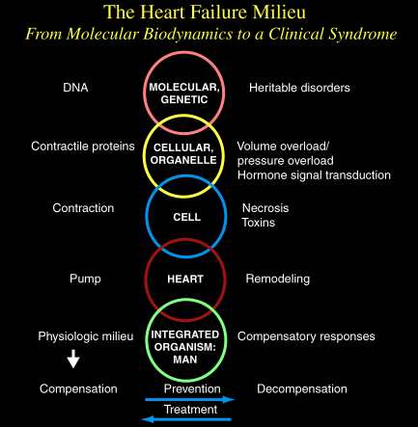
IN HEART FAILURE THERE ARE DISTURBANCES AT EACH LEVEL OF LIFE
MOLECULAR
SUBCELLULAR
CELLULAR
ORGAN
WHOLE BODY
Young, Haas, Starling:
American College of Cardiology,
American Heart Association

Slide 15
etiology of heart failure with reduced and perserved EF
EF < 40% = systolic, „HFrEF“ (reduced EF)
  Coronary artery disease (different forms)
  Pressure overload (hypertension, obstructive valvular conditions)
  Volume overload (regurgitant valvular diseases, congenital conditions with shunts, extracardiac shunts)
  Dilated cardiomyopathies (genetic, metabolic, toxic, viral, m. Chagas)
  Arrhytmias (!)
EF > 40% = diastolic, „HFpEF“ (perserved EF)
  Hypertrophic cardiomyopathies (genetic)
  Restrictive cardiomyopathies
  Hypertension (hypertrophy)
High output
  Thyrotoxicosis
  Beri-beri, anemia, A-V shunts

Slide 16
etiology of heart failure
Overlap
Combination
Genetic background

Slide 17
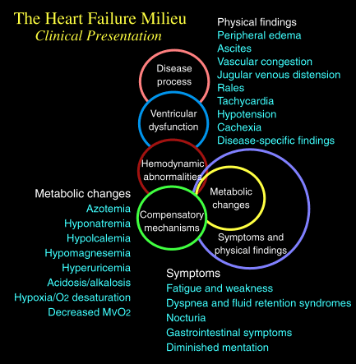
Pathogenesis
and symptoms
of HF

Slide 18
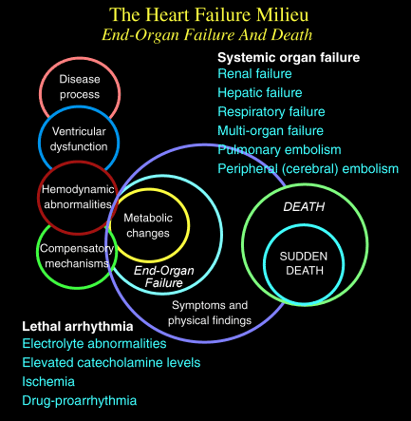
Outcome of HF
(worst case)

Slide 19
Cellular adaptation – maladaptation
Myocytes do not divide
Contractile proteins regenerate (30 – 90 d)
  Stimuli: GH, ATII, Noradrenaline, TNF-α, Interleukins, ADH, NO, ANP…
Growth of cells – hypertrophy
  not a normal structure but back to fetal phenotype (not a full function)
Alterations of contractile proteins
Loss of myocytes through apoptosis/necrosis
Beta-adrenergic desensitation
Reorganization of extracellular matrix – dissolution of the collagen weave and replacement by a matrix NOT supporting myocytes

Slide 20
Neurohumoral (mal)adaptation
Fixed reaction to decrease of cardiac output in shock
Adrenergic stimulation (afferentation through baro & chemoreceptors – CNS)
  Useful for short term, dangerous for long term (arrythmia)
Renin – angiotensin – aldosteron system (RAAS) – renal & local
  Maladaptation
Erytropoetin
  See “Fallot tetralogy”
Subclinical inflammation (TNF-alfa)

Slide 21
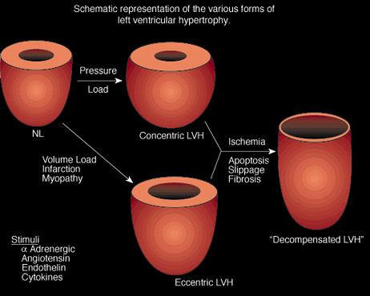
CONCENTRIC & ECCENTRIC HYPERTROPHY,
DILATATION & DECOMPESATION

Slide 22
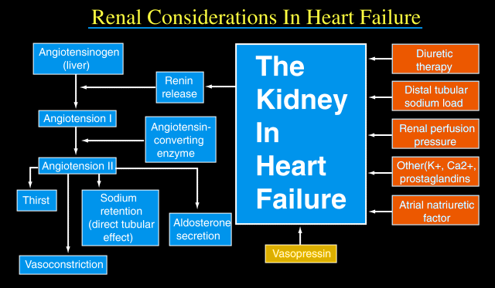
RENIN (ENZYME) SECRETED FROM KIDNEYS
IN HYPOXIA/HYPOPERFUSION.
CONVERSION OF ANGIOTENSINOGEN (PEPTIDE)
TO ANGIOTENSIN I (AT I; PEPTIDE, 10 AA).
CONVERSION OF AT I BY ENZYME ANGIOTENSIN
CONVERTING ENZYME (ACE) FROM LUNGS.
TO ANGIOTENSIN II (AT II; PEPTIDE, 8 AA).
4. AT II IS A STRONG
VASOCONSTRICTOR
ACTIVATOR OF ALDOSTERONE:
  SODIUM RETENTION IN KIDNEYS
  COOPERATION WITH ANTIDIURETIC HORMONE.
5. FLUID RETENTION.
IMPORTANT IN SHOCK STATE
MALADAPTATION IN HEART FAILURE
NATRIURETIC PEPTIDES ARE ANTAGONISTS!

Slide 23
And something new and interesting
GEnetic and functional insights into the fractal* structure of the heart
The inner surface of the human heart are covered by a complex network of muscular strands that is thought to be a remnant of embryonic development. The function of these trabeculae in adults and their genetic architecture are unknown.
GWAS to investigate image-derived phenotypes of trabeculae using the fractal analysis of trabecular morphology in 18,096 participants of the UK Biobank.
16 significant loci containing genes associated with haemodynamic phenotypes and regulation of cytoskeletal arborization were found.
*Fractals are structures appearing the same at different scales. Fractals exhibit similar patterns at increasingly smaller scales, a property called self-similarity.
Examples: snowflakes, coastline of Norway

Slide 24
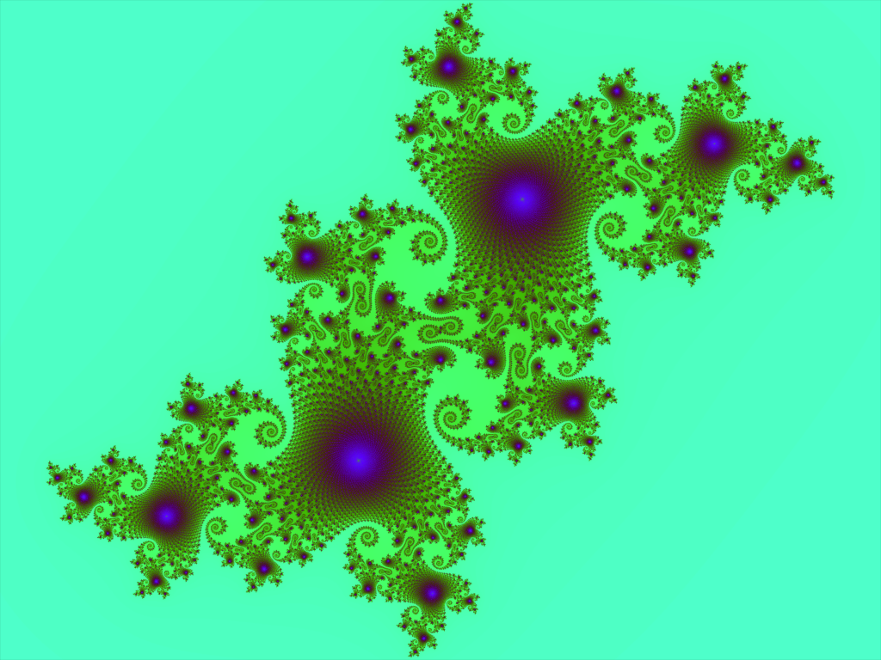
Genetic and functional insights into the fractal structure of the heart (Nature 2020)
Using biomechanical simulation, it was demonstrated, that trabecular morphology is an important determinant of cardiac performance.
There is a causal relationship between trabecular morphology and risk of cardiovascular disease.
These findings suggest a previously unknown role for myocardial trabeculae in the function of the adult heart

Slide 25
Lectures and seminars from pathological physiology
Chapter II
Acquired valvular diseases
Oliver rácz et al, 2024

Slide 26
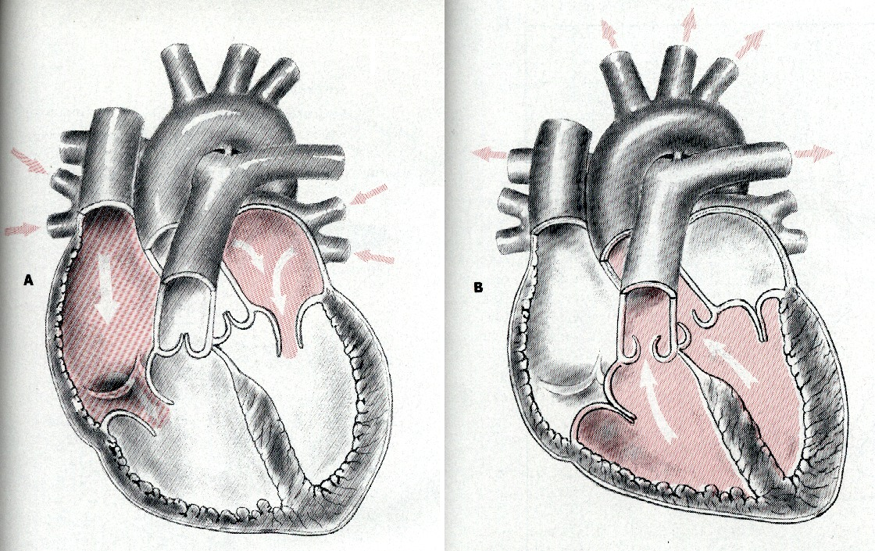
DIASTOLE, SYSTOLE, OPENING & CLOSING OF VALVES

Slide 27
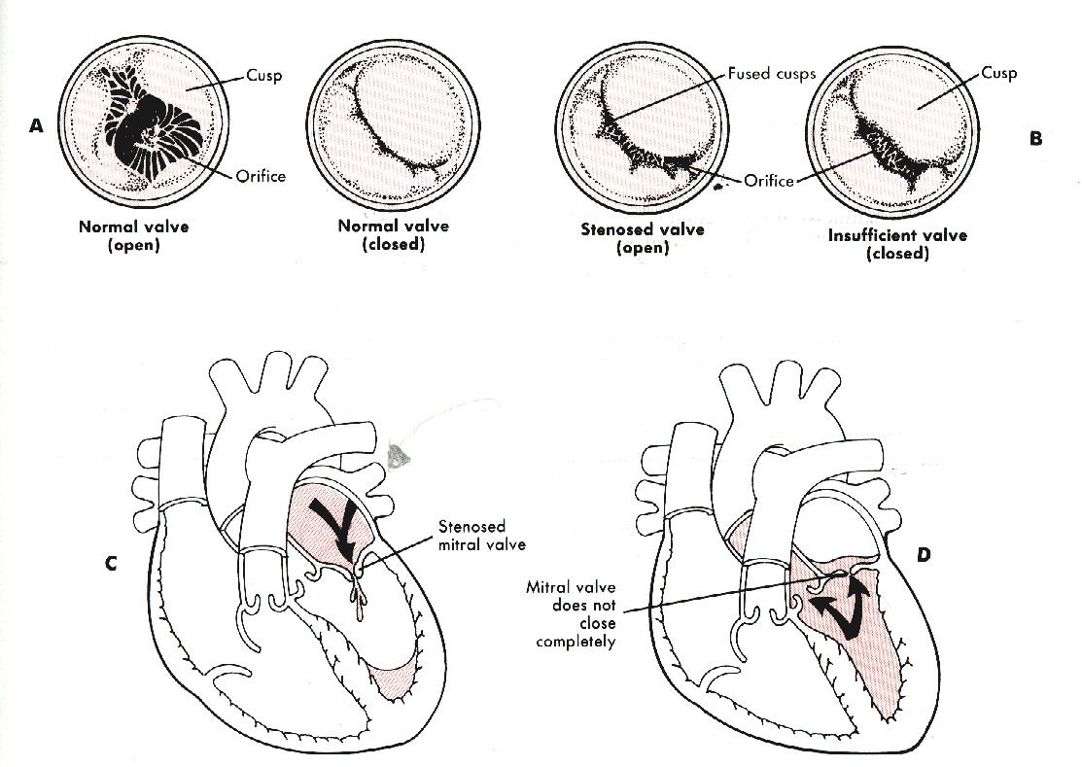
A. NORMAL OPENING & CLOSING OF MITRAL VALVE.
B. STENOSIS & INSUFFICIECNY OF MITRAL VALVE
C. HEMODYNAMIC CONSEQUENCES OF MITRAL STENOSIS (BLOCK OF FLOW)
D. HEMODYNAMIC CONSEQUENCES OF MITRAL INSUFFICIENCY (BACKWARD FLOW)

Slide 28
Valvular dysfunction – introduction
Stenosis – block of flow; regurgitation – backward flow
For pathological physiology the hemodynamics is the most important. It helps to understand heart failure also in other diseases
Symptoms. auscultation (murmurs), USG – see internal propedeutics
In the past mostly consequence of rheumatic fever, today this is changing:
  degenerative processes of valves (ageing of population)
  hereditary causes (mitral valve prolapse, pulmonary, stenosis)
  inflammation
  secondary dilatation (cardiomyopathies, papillary muscle dysfunction)

Slide 29
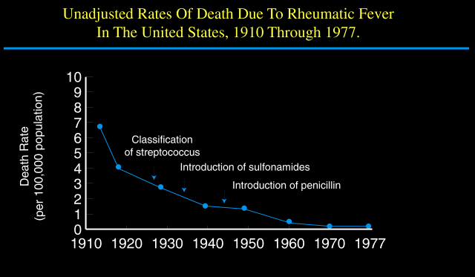
PAST: RHEUMATIC FEVER
RECENTLY: SIGNIFICANT INCREASE OF VALVULAR DISEASES
IN OLDER PEOPLE (EARLY DIAGNOSIS AND INTERVENTION)

Slide 30
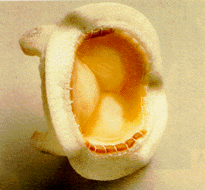
Mitral stenosis
10 – 20 years after febris rheumatica
From 1st symptoms to decompensation: 5 – 10 years
Often in combination with other valvular defects (aortic insufficiency)
Narrowing of the ostium from 4 – 6 to 1 cm² and less
25 years after febris rheumatica most patients were in NYHA III and IV in the past.
Artificial valves from the last century 50’s
Now: Early valvuloplastic intervention by cardiac cathetrisation

Slide 31
Mitral stenosis
Pressure gradient between left atrium and ventricle – first only during exercise, later also in rest
Left ventricle is intact – not involved in compesation
Postcapillary pulmonary hypertension; over 30 mmHg danger of pulmonary oedema
Overload of right ventricle
Symptoms of left heart failure without dysfunction of left ventricle
3 typical complications in the past:
  Atrial fibrillation, thrombus formation and the danger of embolisation

Slide 32
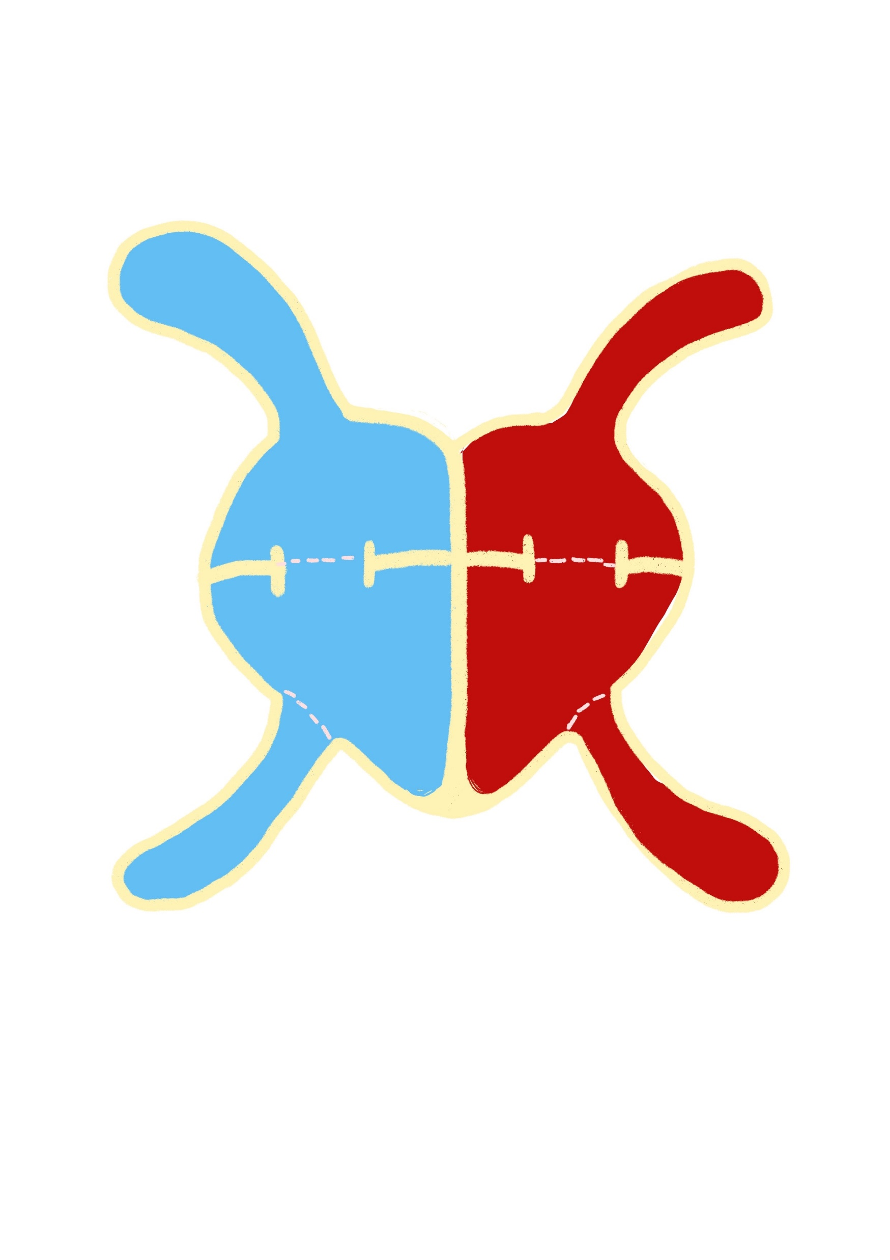
OPEN
CLOSED
STENOTIC
ELEVATED
PRESSURE
DIASTOLE
MITRAL
STENOSIS

Slide 33
Grades of mitral stenosis
 | NORM | MILD | MEDIUM | SEVERE
Area of the ostium, cm² | 4 – 6 | 2 – 4 | 1 – 2 | < 1
Gradient, mmHg | < 5 | 5 – 12 | 12 – 20 | > 20
Halftime of filling, ms | < 60 | 60 – 100 | 100 – 200 | > 200

Slide 34
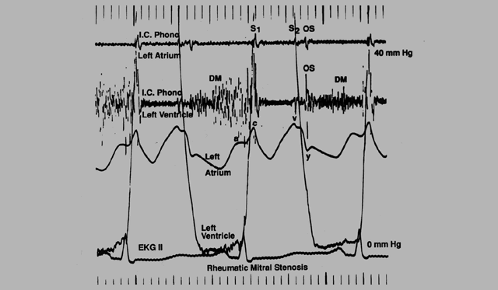
The haemodynamic problem
LA IN NORM
(LOW)
LA IN MITRAL STENOSIS
(INCREASED)

Slide 35
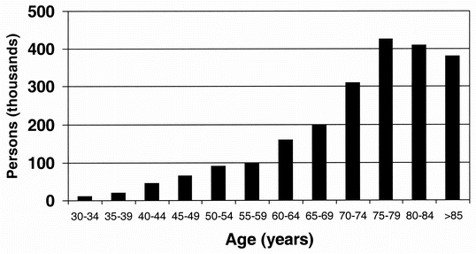
A short diversion towards atrial fibrillation
THROMBOSIS AND EMBOLISATION
Blood stasis in noncontracting atria, thrombus formation
In case of conversion to sinus rhythm danger of embolism
Prevention: Anticoagulant therapy and USG control of the thrombus dissolution
A common dysrythmic condition
Different forms
Diagnosis also without ECG – pulsus irregularis et inaequalis - why?
CAUSE
In the past – mitral stenosis
Today – age, sex (m > w)
  60 y. cca 1 %, 80 y. up to 6 %
  Thyreotoxicosis
  Cardiac disease in general

Slide 36
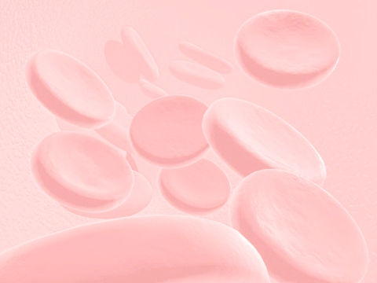
Pulsus irregularis and inaeqalis
IRREGULARIS:
No “P” waves,
Irregular transmission of impulse to ventricles.
The contraction of ventricles is OK (normal QRS)
INAEQUALIS:
Irregular R-R intervals
Long diastole, good ventricle filling
Short diastole, weak ventricle filling

Slide 37
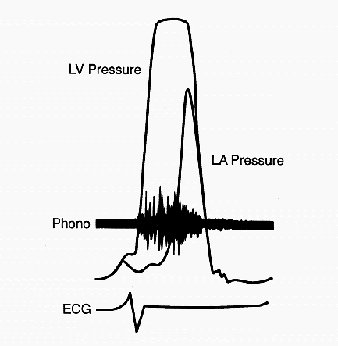
Mitral regurgation (INSUFFICIENCY)
HEMODYNAMICS
Regurgitation from LV back into left atrium during systole
Volume overload of LV (to get 5 liters into circulation the heart pumps 7– 8 and more)
EXCENTRIC HYPERTROPHY of LV compensates the hemodynamic disorder
SYMPTOMS (except murmurs, ECG and X ray picture) are similar to stenosis (left heart failure, pulmonary oedema, complications)

Slide 38
OPEN
CLOSED
REGURGITATION
SYSTOLE
MITRAL
INSUFFICIENCY

Slide 39
Mitral regurgation – new aspects
Recently more common as compared with mitral stenosis
Causes: coronary artery disease, age associated degeneration
Secondary in case of dilated left venrtricle
Possibility of exact assessment through USG
Assessment of the “REGURGITATION JET“
Measurement of REGURGITATION VOLUME to decide about the details of valvuloplastic intervention

Slide 40
Mitral valve prolapse?
CLASSIC DESCRIPTION: Valve prolapse with acute regurgitation after necrosis of papillary muscles or as a part of inherited diseases of collagen (m. Marfan, Ehlers-Danlos) RARE
NEW VIEW: Small regurgitation visible on USG due to incomplete closing of mitral valve, usually without hemodynamic consequences and symptoms.
Present in ≈ 2 - 5% otherwise healthy people (?)
COMMON AD disease? Altered histological structure of valves? Increased risk of sudden death?

Slide 41
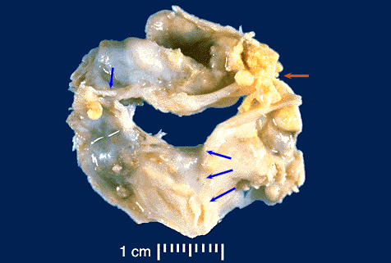
Aortic stenosis
Valvular
Causes
  Hereditary
  1 % of population has bicuspidal aortic valve
  Degeneration, calcification
  Postrheumatic (past)
In addition to valvular also
  Subvalvular – see hypertrophic cardiomyopathy
  Supravalvular – coarctation of aorta
AN EXTREMELY DAMAGED VALVE
WITH CALCIFICATION AND
BACTERIAL VEGETATION

Slide 42
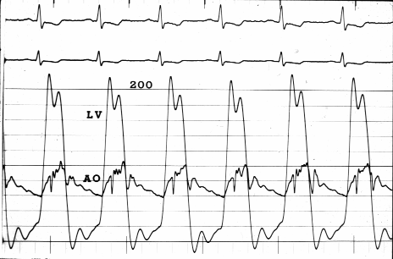
Aortic stenosis
HEMODYNAMICS
Pressure gradient between LV and aorta
Pressure overload of LV (as in hypertension)
CONCENTRIC HYPERTROPHY, well compensated for a long time, diastolic dysfunction. Possibility of decompensation and left heart failure
Pulsus parvus et tardus – insufficient perfusion of tissues, especially of heart muscle

Slide 43
OPEN
CLOSED
STENOTIC
ELEVATED
PRESSURE
SYSTOLE
AORTIC
STENOSIS

Slide 44
Grades of aortal stenosis
 | NORM | MILD | MEDIUM | SEVERE
Area of ostium, cm² | 2 – 3 | 2 – 1,5 | 1,5 – 1 | < 1
Gradient, mmHg | 0 | < 50 | 50 – 70 | > 70

Slide 45
Aortic regurgitation (insufficiency)
Mostly postrheumatic
Hemodynamics: Regurgitation in diastole, volume overload of LV
High systolic and low diastolic pressure – disadvantegous for heart muscle perfusion
Pulsus celer et altus

Slide 46
OPEN
CLOSED
REGURGITATION
DIASTOLE

Slide 47
Overview of valvular defects hemodynamics
 | Disorder | Timing | Overload | Notes
Mitral stenosis | A ⇒V | Diastole | not of left ventricle ! | fibrillation Embolisation
Mitral insufficiency | A ⇐ V | Systole | volume | „exercise“
Aortic stenosis | V ⇒ Ao | Systole | pressure | pulsus !
Aortic insufficiency | V ⇐ Ao | Diastole | volume | pulsus !

Slide 48
The „forgotten“ right ventricle
Often as a „victim“ or „bystander“ of overall pathological cardiac or pulmonary conditions
USG inverstigation is more complicated
Some anatomical, histological and functional specifics (valves, papillar muscles, trabeculisation of the apical part and contraction)
    It is not a smaller, weaker left ventricle

Slide 49
The forgotten ventricle – etiology of pathological conditions
Pressure overload – stenosis of a. pulmonalis, pulmonary HT, pulmonary embolism (acute!)
Volume overload – atrial and ventricular septum defect, tricuspidal regurgitation
Dysfunction of the myocard – myocardial infarction, cardiomyopathies
Obstruction of inflow – tricuspidal stenosis, heart tamponade, constrictive pericarditis
Abusus of some drugs – cocaine, amphetamine

Slide 50
Tricuspidal regurgitation
Common secondary condition in valvular diseases of the left ventricle, in congenital defects and in left ventricle failure
Primary in infectious endocarditis (i.v. drug users), danger of septic pulmonary embolisation
Prolaps – together with the left side
Ebstein anomaly (see in chapter III)

Slide 51
Lectures and seminars from pathological physiology
Chapter III
CONGENITAL Heart DEFECTS
Oliver rácz, et al. 2024

Slide 52
Occurence & clinical significance of congenital heart defects
0,6 – 0,7 % live births (≈ 300/year in SK)
Prenatal and/or very early diagnostics
Early or postponed surgical intervention
Two thirds live up to adult age (sometimes with residual abnormalities)
In the past sometimes (ASD) discovered in adult age
In Slovakia ≈ 10 000 people after cardiac surgery in childhood,
foramen ovale is not closed in 25 % of healthy people – without consequences

Slide 53
Classification
OLD: Cyanotic & noncyanotic
NEW
Defects with shunts (left to right, late cyanosis)
  defects of atrial or ventricular septum, ductus Botalli apertus (ASD, VSD, DBA)
Defects with stenoses
  aortal & pulmonal stenosis, coarctation of aorta
Defects with dyslocation
  dextrocardia, transposition big vessels
Combined – Fallot’s tetralogy and others
They are congenital and mostly NOT hereditary conditions
But there are also hereditary heart pathologies:
Holt-Oram syndrome
Some arrhytmias (chapter VIII)
Hypertrophic and dilated cardiomyopathies (chapter IV)

Slide 54
Embryological development of the heart and the intrauterine circulation
4th week: 5 segments of the embryonal tube:
  sinus venosus, common atrium, common ventricle, bulbus cordis and truncus arteriosus
5th – 8th week: septum formation between the left and right side, valves, endocardium – a very sensitive period of time.
...
Later: Through pulmonary circulation only 5 % of blood.

Slide 55
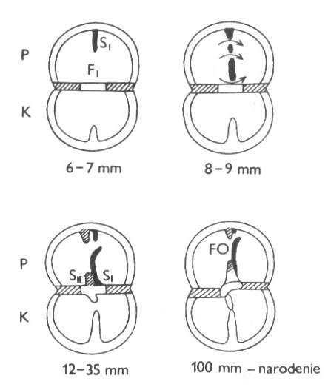
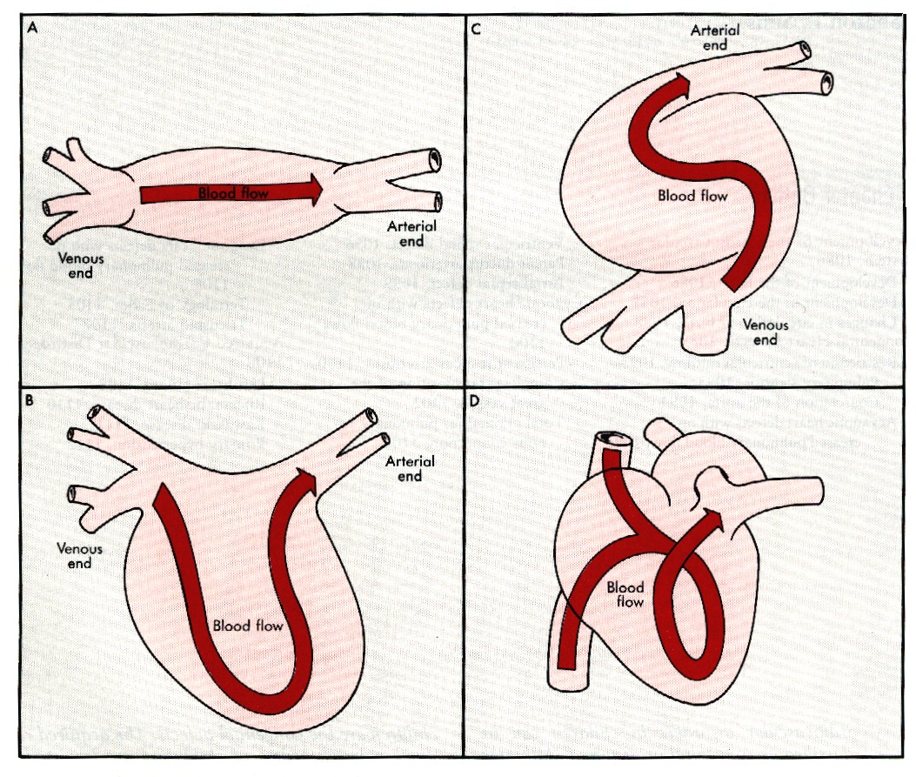
HEART DEVELOPMENT
EARLY AND SENSITIVE

Slide 56
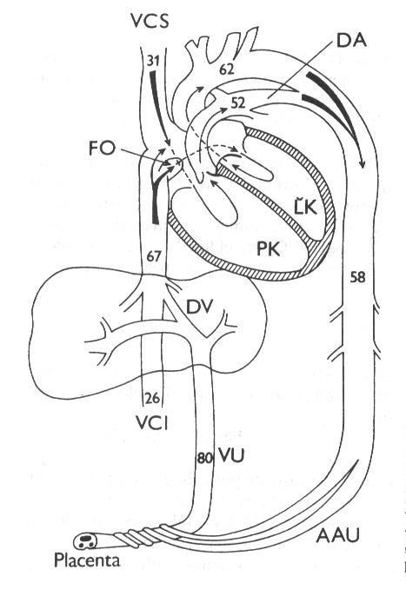
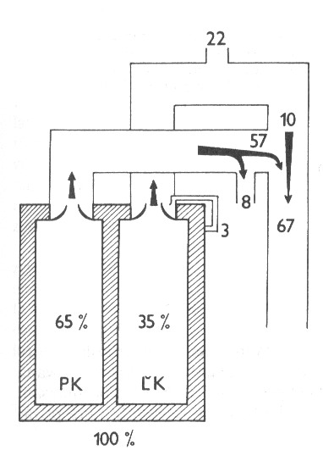
intrauterine circulation
Oxygen through placenta and vena umbilicalis to right atrium
Both ventricles pump blood into systemic circulation (MORE THE RIGHT!)
Foramen ovale open
Ductus arteriosus open
W. Harvey, 1578 - 1657

Slide 57
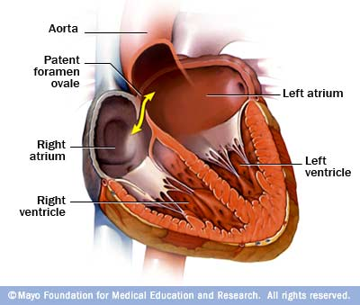
Foramen ovale persistens
MOSTLY NO CLINICAL SIGNS, NO COMPLAINTS
ASSOCIATION WITH MIGRAINE ???

Slide 58
Etiology of congenital heart defects
Viral infection in 5th – 8th gestational week (rubella and other)
  example: child with rubella infects his mother who did not have rubella and waiting the second child
Chemical: alcohol, smoking, immunosuppresive drugs, thalidomid, antimetabolites and other
Hereditary (also – arrythmias, cardiomyopathies, valvular malformations)
As a part of chromosomal aberrations and hereditary diseases
  m. Down, sy. Turner, Marfan etc.
It is theory – the cause is clear only in 10% cases

Slide 59
A short diversion to viruses
Rubella (measles, three-day measles)
Togaviridiaes, Rubivirus (an RNA virus)
Mostly not a serious disease (rash, elevated body temperature, headache…)
Only 0,6 % of infected pregnant women have health damage of the offspring (infections in the 1st trimester are dangerous)
The virus can persist in the body for a long time
Possibilities of other consequences
  Growth retardation, Sensorineural deafness, cataract, urogenital abnormalities, Microcephaly*
  *Zika!!!
  And Coronaviruses (Covid19)? We don’t know yet

Slide 60
Incidency (10⁶ births), 2002
Malformation | Incidence | %
Ventricular septum defect | 4482 | 42
Atrial septum defect | 1043 | 10
Pulmonal stenosis | 836 | 8
Ductus Botalli open | 781 | 7
Fallot tetralogy | 577 | 5
Coarctation of aorta | 492 | 5
AV defect | 396 | 4
Aortic stenosis | 388 | 4
Complete transposition | 388 | 4
Other | 374 | 3

Slide 61
Etiology of congenital heart defects congenital or genetic?
Holt-Oram sy. = ASD, disturbances of upper extremity development.
  Gene for a transcriptional factor, TBX5
Mutation of another transcription factor NKX2-5
  Heterozygotes: ASD, risk of sudden death
  Homozygote drosophila = “tinman”, no heart.
Similar effects as the thalidomid!!!

Slide 62
Atrial septum defect
Not the most common, women > men
2 basic types with left to right shunt.
  ostium secundum
  ostium primum (+ abnormalities of AV valves)
  and abnormal position of pulmonary venes
Increased blood flow through pulmonary circulation, later pulmonary hypertension.
Dg. sometimes in adult life – dyspnoe, fatigue, supraventricular tachyarrhytmias.

Slide 63
ATRIAL SEPTUM DEFECT
CO RIGHT > CO LEFT

Slide 64
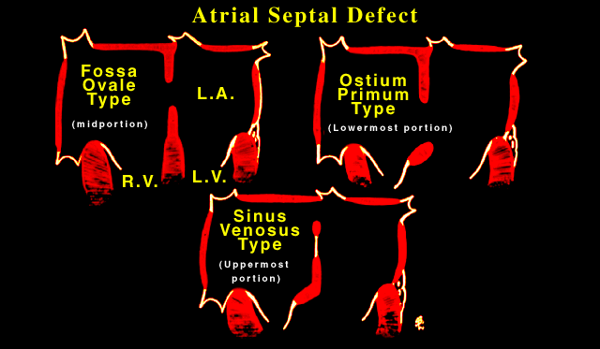
DIFFERENT ANATOMICAL SITUATIONS

Slide 65
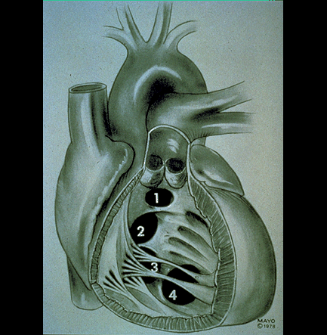
Ventricular septum defect
80 % p. membranacea
15 % p. muscularis (m. Roger – small hole, strong murmur)
Pulmonary circulation overload, pulmonary hypertension

Slide 66
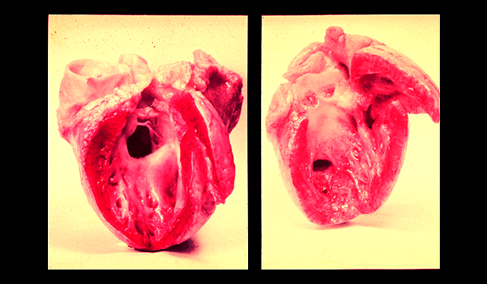
Ventricular septum defect
25 – 40 % of congenital heart malformations
25 % died before age 20 years but 66% live up to 60
Most small defects close spontaneously before age 10

Slide 67
VENTRICULAR SEPTUM DEFECT
CO RIGHT > CO LEFT
BIG DIFFERENCE
BETWEEN SYSTOLIC
PRESSURE IN LEFT
AND RIGHT VENTRICLE

Slide 68
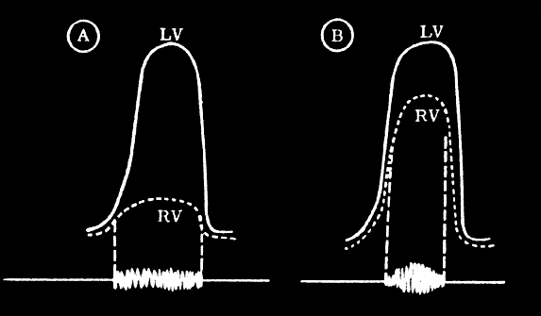
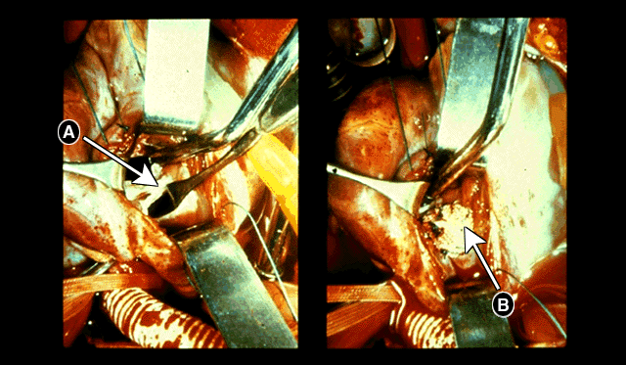
PAST: OPEN HEART SURGERY
NOW CATHETER INTERVENTION

Slide 69
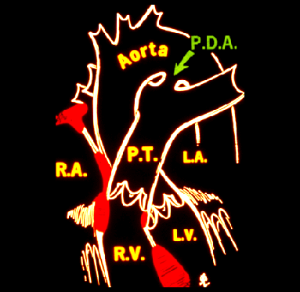
Open ductus Botalli
Closing in full-term newborns in 24 h
DBA often in premature newborns
Pulmonary circulation overload
Big shunt can cause heart failure
Risk of bacterial endocarditis

Slide 70
DUCTUS BOTALI PERSISTENT
CO RIGHT > CO LEFT
ABNORMAL FLOW
BOTH IN SYSTOLE
AND DIASTOLE

Slide 71
Eisenmenger syndrome
ASD, VSD, DBA with pulmonary hypertension
IF NOT TREATED, right to left shunt develops
Cyanosis, polyglobulia
Dyspnoe, fatigue, syncopa, oedema
Too late for surgery

Slide 72
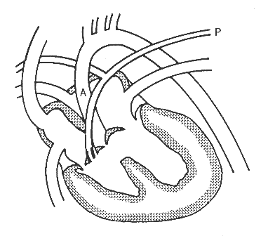
Fallot tetralogy
1. Pulmonary stenosis
2. subaortal VSD
3. riddling aorta
4. right ventricular hypertrophy.
VERY SERIOUS CONDITION
strong cyanosis, hypoxia
growth retardation
Ht, Hb, Er – high blood viscosity.

Slide 73
Fallot PENTAlogy – WORSE?
1. Pulmonary stenosis
2. subaortal VSD
3. riddling aorta
4. right ventricular hypertrophy
5. DUCTUS BOTALLY OPEN
LESS SEVERE
WHY?
The open DB improves pulmonary circulaton
BLALOCK AND TAUSSIG (50’s)
Arteficial DB, improving pulmonary
Circulation, bettes prognosie

Slide 74
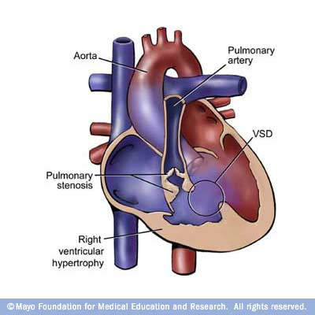
Fallot tetralogy

Slide 75
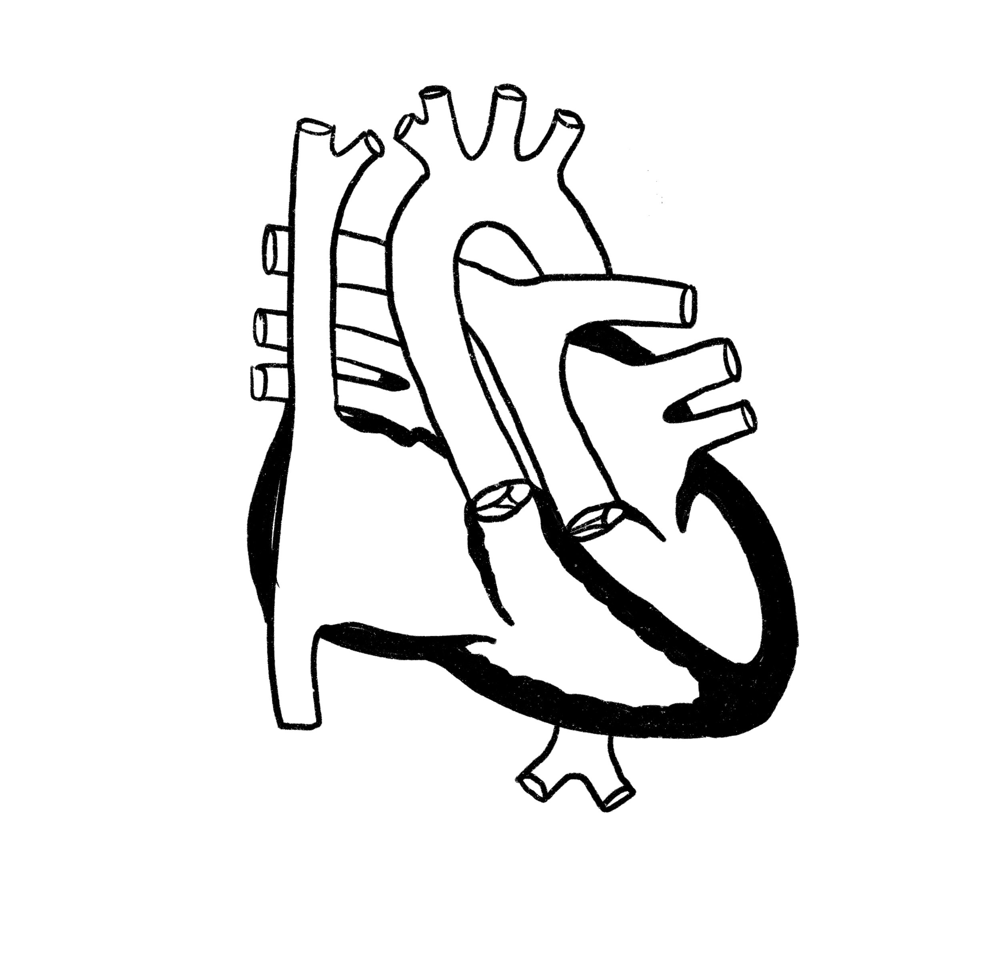
Transposition of aorta and a. pulmonalis???
TWO PARALLEL CIRCULATIONS!
1. Left ventricle → A. pulmonalis → lungs → pulmonary venes → left atrium → left ventricle
OXYGENATED BLOOD NOT GOING INTO THE BODY
2 Right ventricle → Aorta → body → cena cava inferior, superior → right atrium → right ventricle
DEOXYGENATED BLOOD IN THE BODY

Slide 76
Transposition of aorta and a. pulmonalis???
TWO PARALLEL CIRCULATIONS!
OXYGENATED BLOOD NOT GOING INTO THE BODY
DEOXYGENATED BLOOD IN THE BODY
LIMITED SURVIVAL IS POSSIBLE BY ASD & OPEN DUCTUS BOTALLI

Slide 77
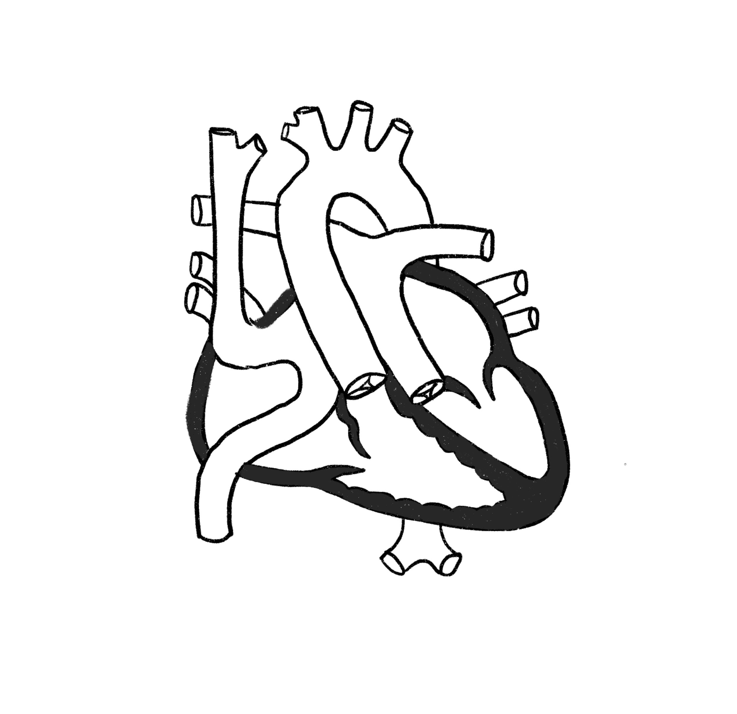
Transposition of aorta and a. pulmonalis
SOLUTION
EXCHANGE THE AORTA AND PULMONALIS NOT POSSIBLE
Paradox situation solved by paradox solution
EXCHANGE OF INFLOW (ATRIA AND VENES) !!!
Right ventricle → aorta – body – vena cava inferior, superior → left atrium → left ventricle → a. pulmonalis → lungs → right atrium → right ventricle
COMPLETELY INVERTED CIRCULATION BUT WORKING
10-year survival is good (limited exercise capacity)
Later decompensation of systemic right ventricle, arrhytmias

Slide 78
And something very different – Ebstein anomaly
Ebstein - abnormal tricuspid valve and hinge apparatus, displaced into the ventricle
It belongs to "endocardial cushion defects“
Endocardial cushion is important in the formation of the AV area, the lower part of the atrial and upper part of the ventricular septum
This type of developmental defects account for up to 5% of congenital heart disease
Up to 50% occurring in children with m. Down - tohether with ASD and VSD & valvular anomalies

Slide 79
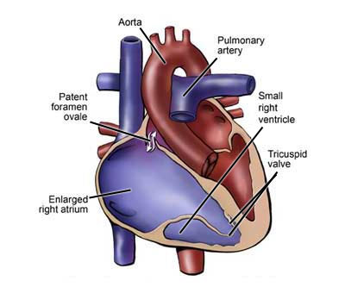
Ebstein ANOMALY
Abnormal tricuspidal valve the septal and posterior leaflet displaced into the ventricle
„Atrialisation“ of the right ventricle which is contracted as a ventricle
Regurgitation (small or significant), hemodynamics worsened with ventricular contraction in exercise
Often associated with atrial septum defect and Wolf-Parkinson-White syndrome

Slide 80
Ebstein ANOMALY
Symptoms depend on regurgitation – pulmonary circulation overload, right ventricle failure
Bad prognosis if the abnormality is manifest in small children
Sometimes discovered later (less pronounced symptoms)
Risk factors ???
  Líthium, benzodiazepam, organic solvents use in mother (???)
  Spontaneous abortion in personal history

